Slide 1
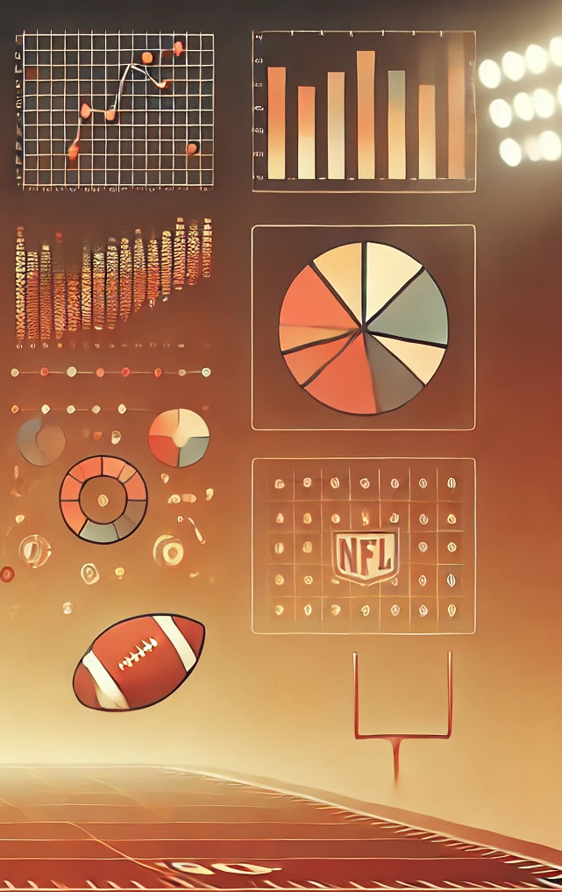
Winning Fantasy Football*
*with a Predictive Neural Net
Ryan Shaffer

Slide 2
Agenda
Project Overview, Motivation, and Fantasy Football Crash Course
Neural Net Fundamentals
Solution Architecture
Neural Network Architecture and Input/Output Data
Training, Validation, and Test Process
Ideal vs. Poor Performance
Hyper-Parameter Tuning
Current Best Model Performance
Emergent Behavior
Comparison to Other Projections
Path Forward: Improvements, Limitations

Slide 3
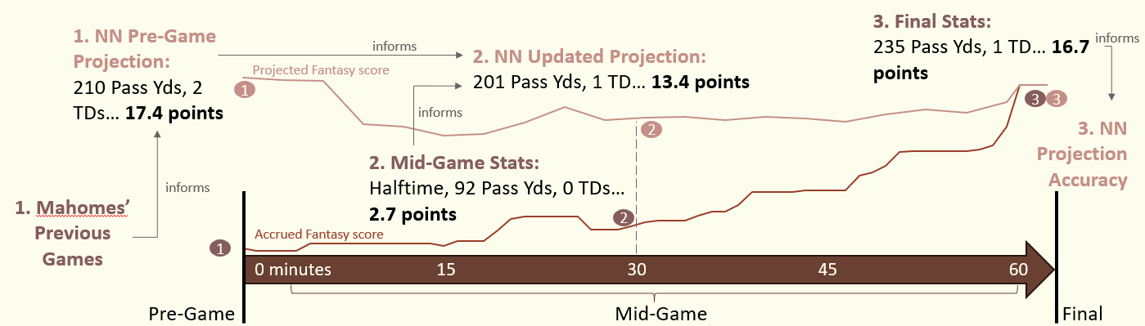
Project Overview
Goal: Design and train a Neural Net (NN) to accurately predict an NFL player’s final game stats and Fantasy Football score, given pre-game context and/or a mid-game snapshot of the player’s ongoing performance.
Example of Use: Patrick Mahomes (Quarterback for Kansas City Chiefs) playing in 2023 Week 16 against the Las Vegas Raiders:

Slide 4
Project Motivation
Personal goals of project:
Gain hands-on experience with Machine Learning techniques and tools
Refresh my Python development skills (most of my professional scripting work is in MATLAB)
Explore and implement best practices of open-source/collaborative software projects
Disclaimer:
This has been a learning-focused project for me, and is my first (self-taught) foray into Machine Learning and Neural Nets
More likely than not, there are flaws in my chosen NN architecture, gaps in my theoretical understanding, and inefficiencies in my codebase
In this presentation and in the project at large, I am focused on the journey rather than the destination

Slide 5
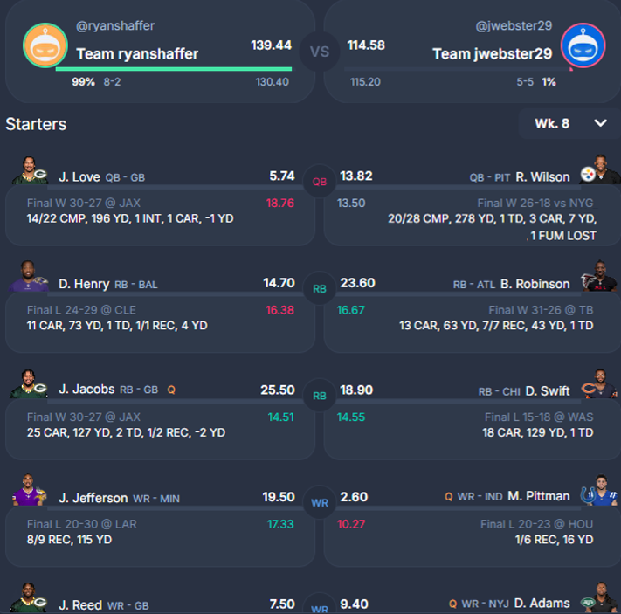
Fantasy Football Crash Course
Premise of Fantasy Football:
You can create a “fantasy” football team made up of real-life NFL players from all around the country
When the NFL players play on their (real) teams each week, their stats – touchdowns, yards gained, pass receptions, etc. – translate into points for your fantasy team
Each fantasy football team has a Quarterback (QB) and multiple Running Backs (RB), Wide Receivers (WR), etc. The points from each player add up to a total score for your fantasy team
Play against your friends, who have their own teams of competing players

Slide 6
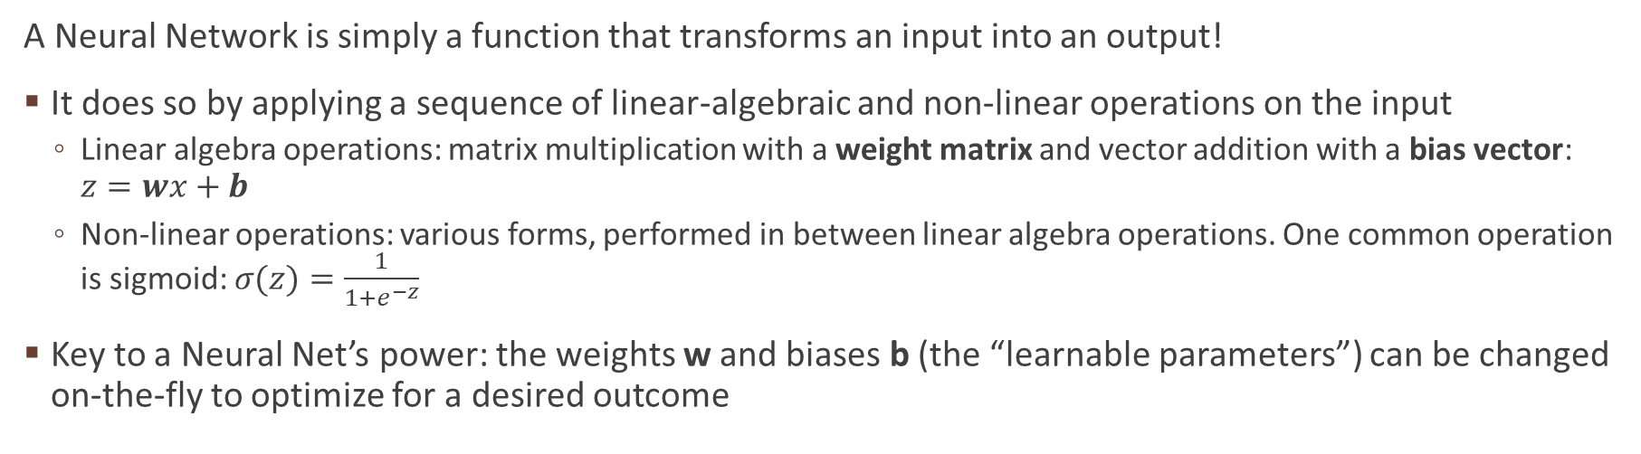
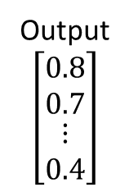
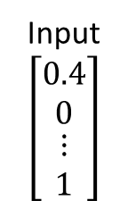
Neural Network Fundamentals
Input
$$\left[\begin{matrix}0.4 \\ 0 \\ \begin{matrix}⋮ \\ 1\end{matrix}\end{matrix}\right]$$
Output
$$\left[\begin{matrix}0.8 \\ 0.7 \\ \begin{matrix}⋮ \\ 0.4\end{matrix}\end{matrix}\right]$$
Linear-algebraic operation
Non-linear operation
A Neural Network is simply a function that transforms an input into an output!
It does so by applying a sequence of linear-algebraic and non-linear operations on the input
Linear algebra operations: matrix multiplication with a weight matrix and vector addition with a bias vector: $z=wx+b$
Non-linear operations: various forms, performed in between linear algebra operations. One common operation is sigmoid: $σ(z)=\frac{1}{1+e^{−z}}$
Key to a Neural Net’s power: the weights w and biases b (the “learnable parameters”) can be changed on-the-fly to optimize for a desired outcome

Slide 7
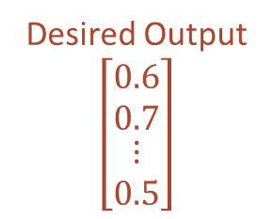
Neural Network Fundamentals: Learning
Input
$$\left[\begin{matrix}0.4 \\ 0 \\ \begin{matrix}⋮ \\ 1\end{matrix}\end{matrix}\right]$$
Output
$$\left[\begin{matrix}0.8 \\ 0.7 \\ \begin{matrix}⋮ \\ 0.4\end{matrix}\end{matrix}\right]$$
Desired Output
$$\left[\begin{matrix}0.6 \\ 0.7 \\ \begin{matrix}⋮ \\ 0.5\end{matrix}\end{matrix}\right]$$
-
Linear-algebraic operation
Non-linear operation
influences
w and b can be modified in order to minimize the difference between the NN’s generated output and a desired output
By minimizing the differences across many generated outputs and desired outputs, w and b can be set in such a way that all the provided inputs generate (roughly) correct outputs
Such a model could generalize to even more input/output pairs*, and thus be applicable in real-world use cases to predict unknown outputs
*provided the new input/output pairs are similar to those already provided

Slide 8
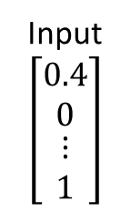
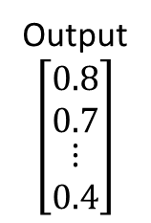
Neural Network Fundamentals: Layers
Input
$$\left[\begin{matrix}0.4 \\ 0 \\ \begin{matrix}⋮ \\ 1\end{matrix}\end{matrix}\right]$$
Output
$$\left[\begin{matrix}0.8 \\ 0.7 \\ \begin{matrix}⋮ \\ 0.4\end{matrix}\end{matrix}\right]$$
Neural Nets typically have one or more “layers” between their input and output
A layer is simply a sequence of a linear and a non-linear operation
Layers between the input and output can be designed for different purposes
Connecting different portions of the data to strengthen or isolate correlations
Big layers (larger matrices): Expanding the dimensionality to gain more learnable parameters
More learnable parameters = more knobs to turn when optimizing
Small layers: Mapping input data to a lower dimensionality and grouping similar inputs together

Slide 9
Network Architecture: Input Data
Input Layer
Elapsed Time
Input data provided to the NN is a vector representing a snapshot of a player’s current (mid-game) situation
A unique input vector is defined for every player, every minute of every game
610,000 inputs for the top 300 NFL players between 2021 and 2023
393 rows in the input vector, broken into 4 categories:
Game Context (29 rows): elapsed game time, player stats accrued so far, game score, field position, etc.
Player ID (300 rows, one for each player – corresponding row marked 1, all others filled with 0)
Team ID (32 rows, one for each team)
Opponent ID (32 rows, one for each opposing team)
Game Context
Current Pass Att
n=29
Player Position
Player=A.J Brown
Player ID
Player=Aaron Jones
n=300
Player=Zay Jones
Team=ARI
Team ID
Team=ATL
n=32
Team=WAS
Opp=ARI
Opponent ID
Opp=ATL
n=32
Opp=WAS

Slide 10
Network Architecture: Output Data
Input Layer
Output Layer
Elapsed Time
Output data generated by the NN is a vector representing the player’s stats at the end of the game
12 rows in the output vector, each corresponding to a statistic
Every input vector has a corresponding output vector
All the output vectors are (by definition) identical for the same player in the same game
The “true” output vector for all past games can be easily found online, providing an objective comparison to the NN’s generated output
Pass Att
Game Context
Current Pass Att
n=29
Pass Cmp
Player Position
Pass Yds
Player=A.J Brown
Pass TD
Player ID
Player=Aaron Jones
Int
n=300
Player=Zay Jones
Rush Att
Team=ARI
Rush Yds
Team ID
Team=ATL
Rush TD
n=32
Rec
Team=WAS
Rec Yds
Opp=ARI
Opponent ID
Opp=ATL
Rec TD
n=32
Fmb
Opp=WAS

Slide 11
Network Architecture: Embedding
Input Layer
Embedding Layer
Output Layer
Elapsed Time
Player ID, Team ID, and Opponent ID each get a dedicated, isolated embedding layer
Embedding: Mapping input data to a lower dimensionality and grouping similar inputs together
Intent of these matrices is to train parameters to predict similar scores for “similar” players/teams
All weights and biases in the embedding matrix are learnable parameters, so “similar” can be figured out during the learning process
Pass Att
Game Context
Current Pass Att
n=29
Pass Cmp
Player Position
Pass Yds
E_{player}
Player=A.J Brown
Pass TD
Player ID
Player=Aaron Jones
Int
n=300
n=50
Player=Zay Jones
Rush Att
E_{team}
Team=ARI
Rush Yds
Team ID
Team=ATL
Rush TD
n=32
n=10
Rec
Team=WAS
E_{opponent}
Rec Yds
Opp=ARI
Opponent ID
Opp=ATL
Rec TD
n=32
n=10
Fmb
Opp=WAS

Slide 12
Network Architecture: Interconnection
Input Layer
Embedding Layer
Interconnected Layer
Output Layer
Elapsed Time
Pass Att
Game Context
Current Pass Att
n=29
Pass Cmp
Player Position
Pass Yds
E_{player}
Player=A.J Brown
Pass TD
Player ID
Player=Aaron Jones
Int
n=300
n=50
Player=Zay Jones
Rush Att
E_{team}
Team=ARI
Rush Yds
Team ID
Team=ATL
n=300
Rush TD
n=32
n=10
Rec
Team=WAS
E_{opponent}
Rec Yds
Opp=ARI
Opponent ID
Opp=ATL
Interconnected Layer allows for cross-correlation of input data categories and expands dimensionality (more parameters)
Rec TD
n=32
n=10
Fmb
Opp=WAS

Slide 13
Network Architecture: Summary
Input Layer
Embedding Layer
Interconnected Layer
Output Layer
Elapsed Time
Pass Att
Game Context
Current Pass Att
n=29
Pass Cmp
Player Position
Pass Yds
E_{player}
Player=A.J Brown
Pass TD
Player ID
Player=Aaron Jones
Int
n=300
n=50
Player=Zay Jones
Rush Att
E_{team}
Team=ARI
Rush Yds
Team ID
Team=ATL
n=300
Rush TD
n=32
n=10
Rec
Team=WAS
E_{opponent}
Rec Yds
Opp=ARI
Embedding Layer: 15,710
Interconnected Layer: 30,000
Output Layer: 3,612
Total Learnable Parameters: 49,322
Opponent ID
Opp=ATL
Rec TD
n=32
n=10
+
Fmb
Opp=WAS

Slide 14
Training, Validation, and Test Data
All input/output data is split into three datasets, each serving a different purpose
Training Data: directly impacts the NN’s weights and biases via learning algorithm
“Answer key provided” to the NN to support learning
Validation Data: “practice test” during training, not directly impacting weights/biases
Test Data: final verification of NN performance in an operational use case
Each dataset should be independent yet representative of the full population
In this application, datasets have been split up temporally by season/week
Mirrors an operational use case – predictions for upcoming games based on past games
Training Data
Validation Data
Test Data
2021
2022
2023, Weeks 1-11
12-14
15-17

Slide 15
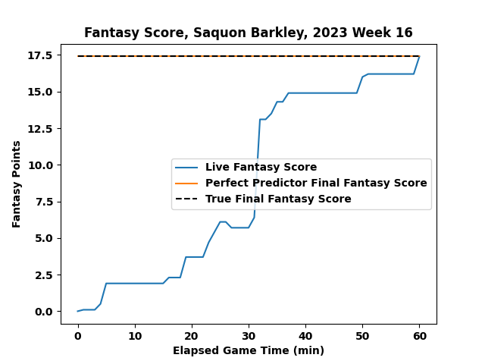
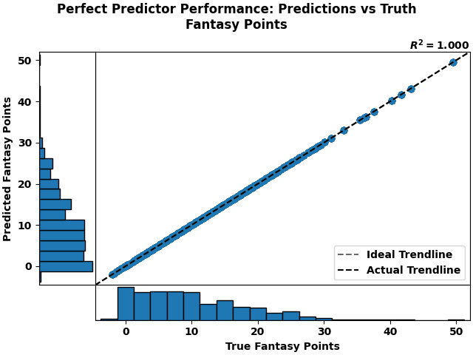
Ideal Neural Net Behavior
Example, single-game:
Across all test data:
Notes:
Every player, every game, a perfect predictor would be able to exactly match the player’s eventual fantasy score at the game’s end
The prediction would remain constant throughout the game, even through large swings of the mid-game stats
In aggregate, the trend between true and predicted fantasy scores would be 1:1

Slide 16
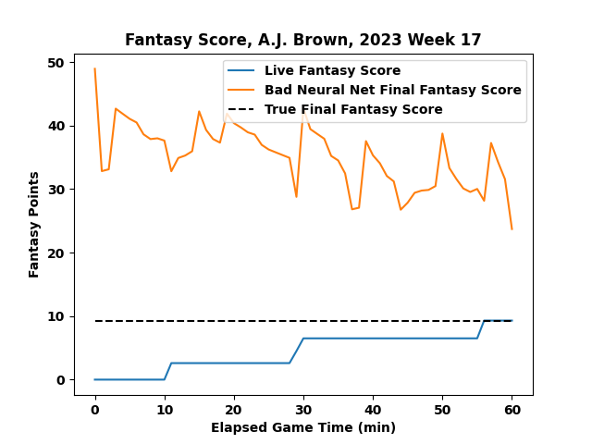
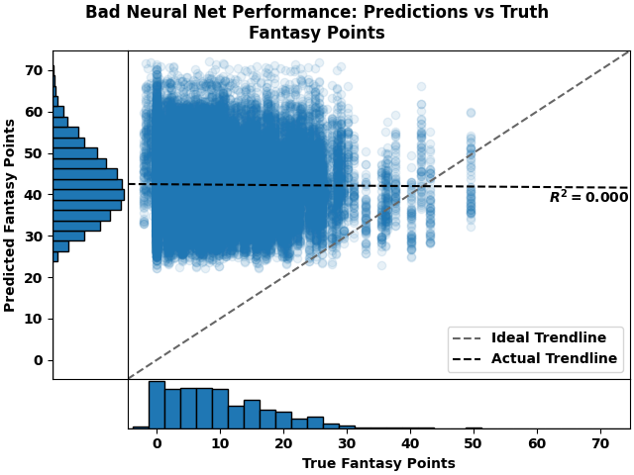
Poorly-Trained Neural Net Behavior
Example, single-game:
Across all test data:
Notes:
Conversely, a poorly-trained neural net does not remotely match its prediction to the player’s fantasy score
Wild swings in projected points over the course of the game, not tied to any swings in the live stats
No discernible trends in the true vs predicted game stats
Neural net is a random number generator with an improper distribution function

Slide 17
Hyper-Parameters
Hyper-parameters are factors in the equations of Machine Learning which cannot be adjusted during the learning process, and must be set a priori
Examples:
Batch Size: number of training datapoints to use in each learning iteration
Learning Rate (η) and Regularization (λ): relative weights of “fast” vs “steady” training adjustments (sort of)
Problem: The NN behavior is strongly driven by hyper-parameters
Often make the difference between signal and noise
An ideal combination is difficult to find theoretically/intuitively
Approach: find an optimal combination of hyper-parameters empirically, by implementing an automatic recursive grid search to try out many combinations

Slide 18
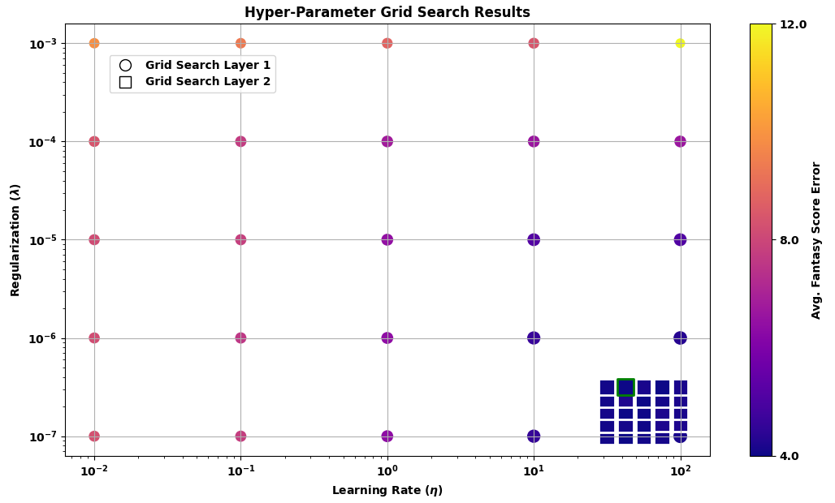
Hyper-Parameter Tuning
Holding batch size constant at 1000, and varying both learning rate and regularization over wide ranges
1st layer finds a broad solution region, and 2nd layer finds a more precise optimum
Simple and robust, but computationally inefficient
Extensible to higher dimensions to test more hyper-parameters simultaneously

Slide 19
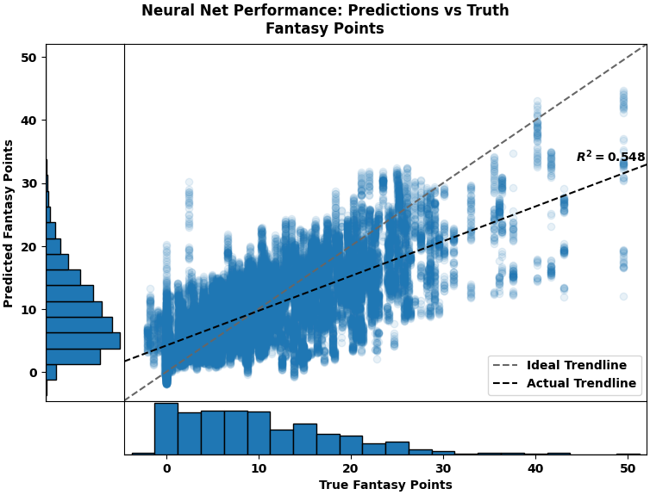
Current Model Performance
After implementing hyper-parameter tuning, a signal emerges!
Key takeaways:
NN is following the right trend: the NN tends to predict higher fantasy scores for players who are really getting higher fantasy scores
NN is starting to predict a reasonable distribution of scores across the full dataset, but still not matching the true distribution
Average absolute error in fantasy score predictions across the full test dataset: 4.19 points
For only pre-game predictions: 5.93 points

Slide 20
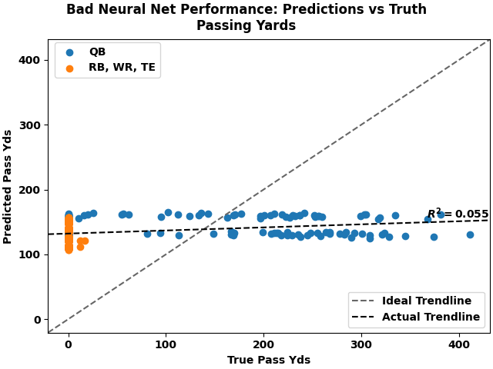
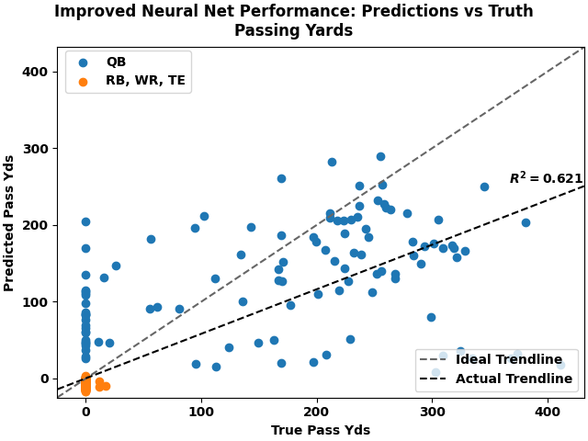
Emergent Behavior: Understanding Positions
Football Truism #1: quarterbacks generally pass the football; non-quarterbacks typically don’t make passes
Passing Yards show a significant difference between quarterbacks (QB) and non-quarterbacks (RB, WR, TE)
The improved Neural Net demonstrates this pattern in its predictions
Thus, the Neural Net has learned the trend that quarterbacks pass and others don’t!
Improvement due to hyper-parameter tuning

Slide 21
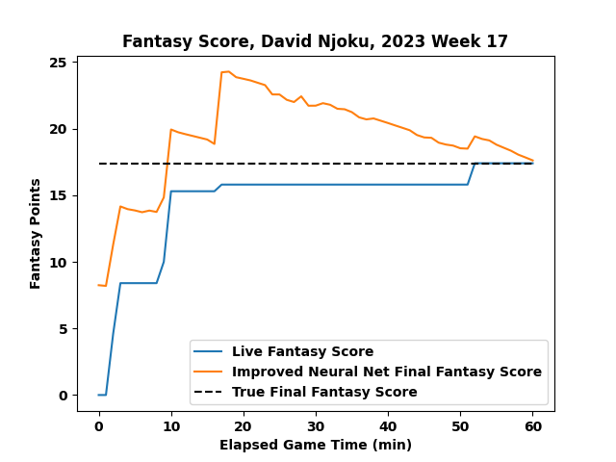
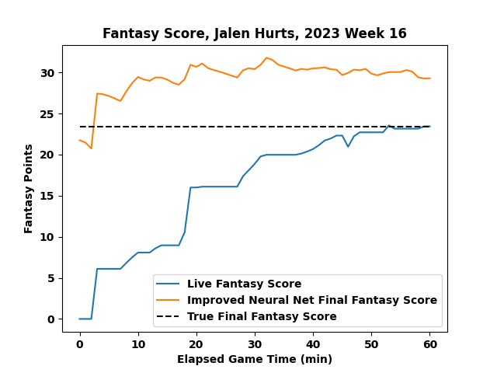
Emergent Behavior: Learning Game Time
Football Truism #2: as the game comes to an end, players’ stats stop changing
In some cases, the NN seems to “understand” this trend
Predicted score for a player trends downwards as the game progresses, since there is less opportunity to score more points
Predicted score spikes upwards (often aggressively) whenever points are scored
Predicted score converges to the actual score at the end of the game
The NN does not always follow this trend
Future improvements to the model may improve this trend

Slide 22
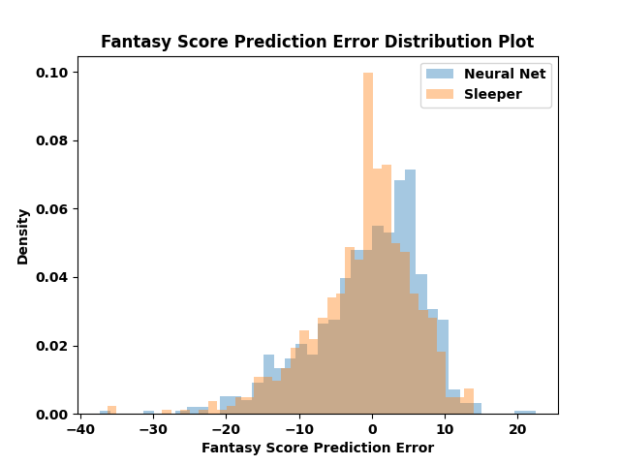
Model Performance Comparison
Sleeper is a popular Fantasy Football app with fairly accurate pre-game projections
Sleeper’s average absolute error in pre-game predictions across the test dataset: 5.16 points
Neural Net is not too far behind an industry standard!
Predictor | Pre-Game Projections, Avg. Absolute Error | Mid-Game Projections, Avg. Absolute Error
Neural Net | 5.93 points | 4.19 points
Sleeper | 5.16 points | TBD

Slide 23
Improvements and Limitations
Plans to improve performance further:
Include more input variables to give the model more useful context
Tune NN architecture (number of layers & neurons) using the Hyper-Parameter tuning process
Faster optimization techniques than grid search: Bayesian methods, genetic algorithm?
Investigate different approaches to input/output normalization and neuron activation
Containerize and utilize cloud compute to accelerate training
Issues that may limit the achievable performance:
Training data quantity is fixed, assuming that years-old NFL games are no longer relevant in predicting today’s outcomes
Rookies entering the NFL have no past NFL performance from which to learn (embedding problem)
Could try to mitigate by including proxy data: college stats, draft position, etc.

Slide 24







Resources and Tools
Learning Resources
Neural Networks and Deep Learning, Michael Nielsen http://neuralnetworksanddeeplearning.com/index.html
3Blue1Brown, Neural Networks video series https://www.youtube.com/playlist?list=PLZHQObOWTQDNU6R1_67000Dx_ZCJB-3pi
MIT Open Learning Library, Intro to Machine Learning https://openlearninglibrary.mit.edu/courses/course-v1:MITx+6.036+1T2019/course/
Software Tools
Python – all source code
PyTorch: Neural Network base class, ML algorithms implementation
Common data analysis libraries: NumPy, Pandas, Matplotlib
Football statistics APIs: Sleeper, nfl-data-py
GitHub: https://github.com/ryanshaffer1/FantasyProjections

Slide 25
Questions?

